Slide 1


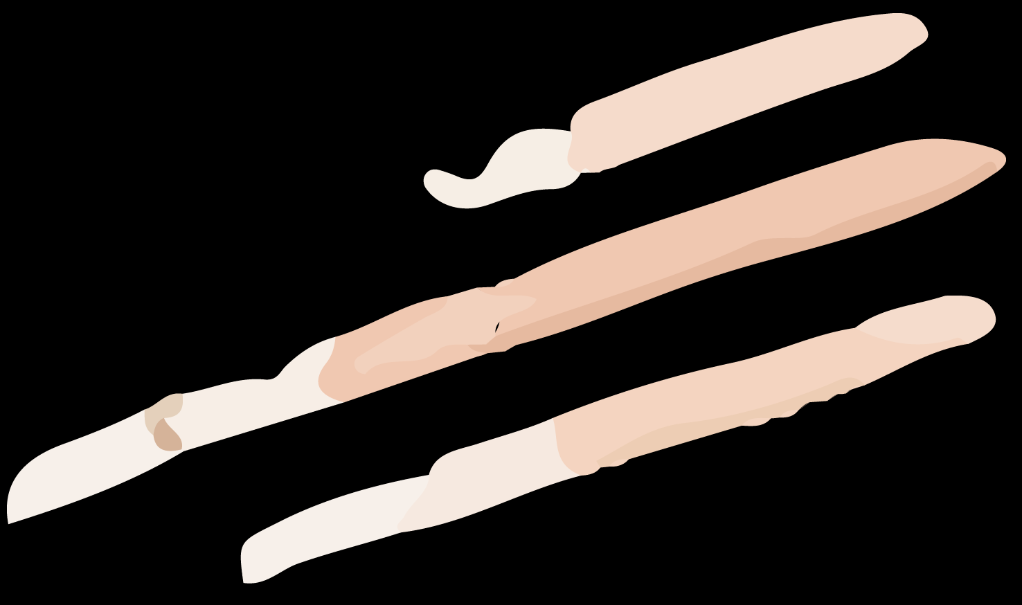
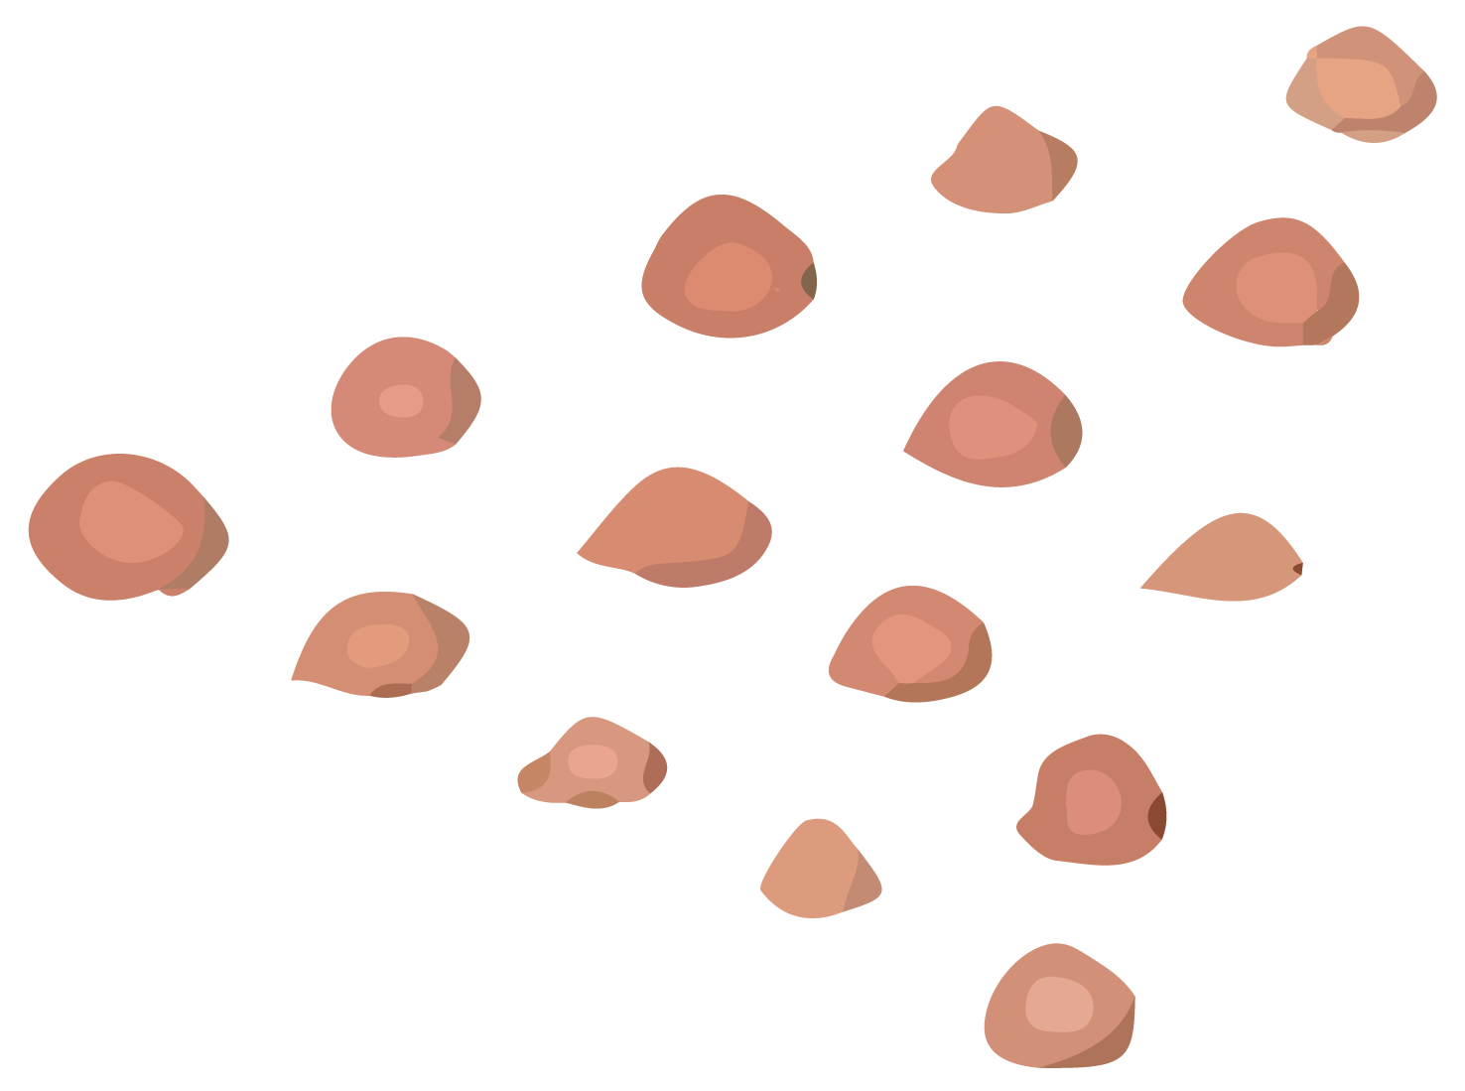

Define and Ideate
Painting a future of learning

Slide 2
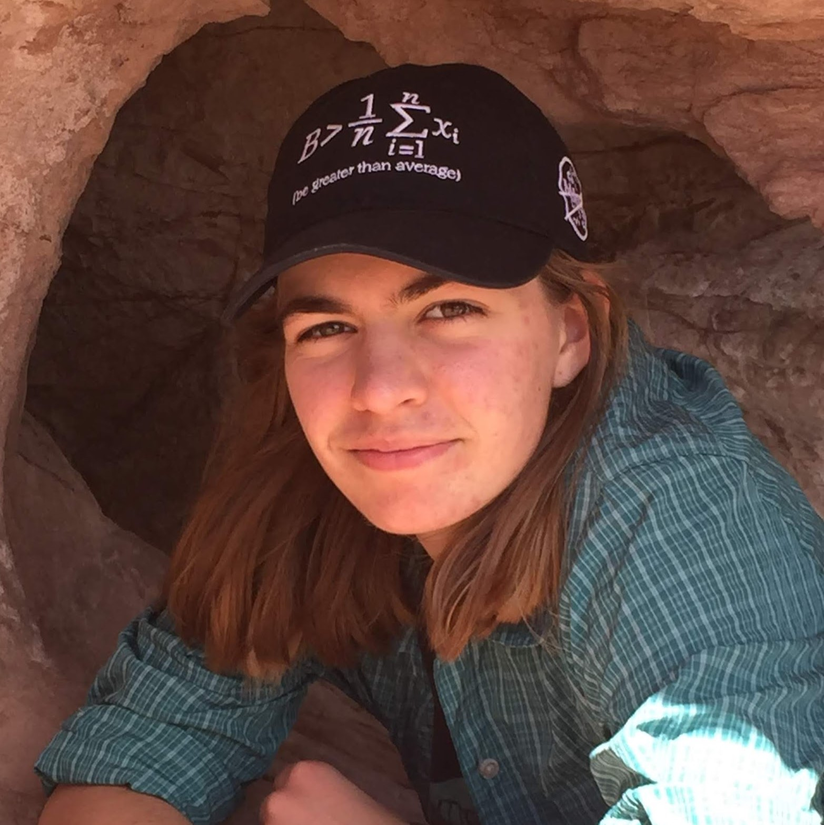
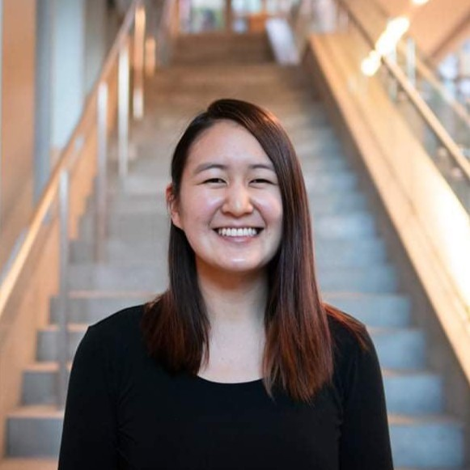
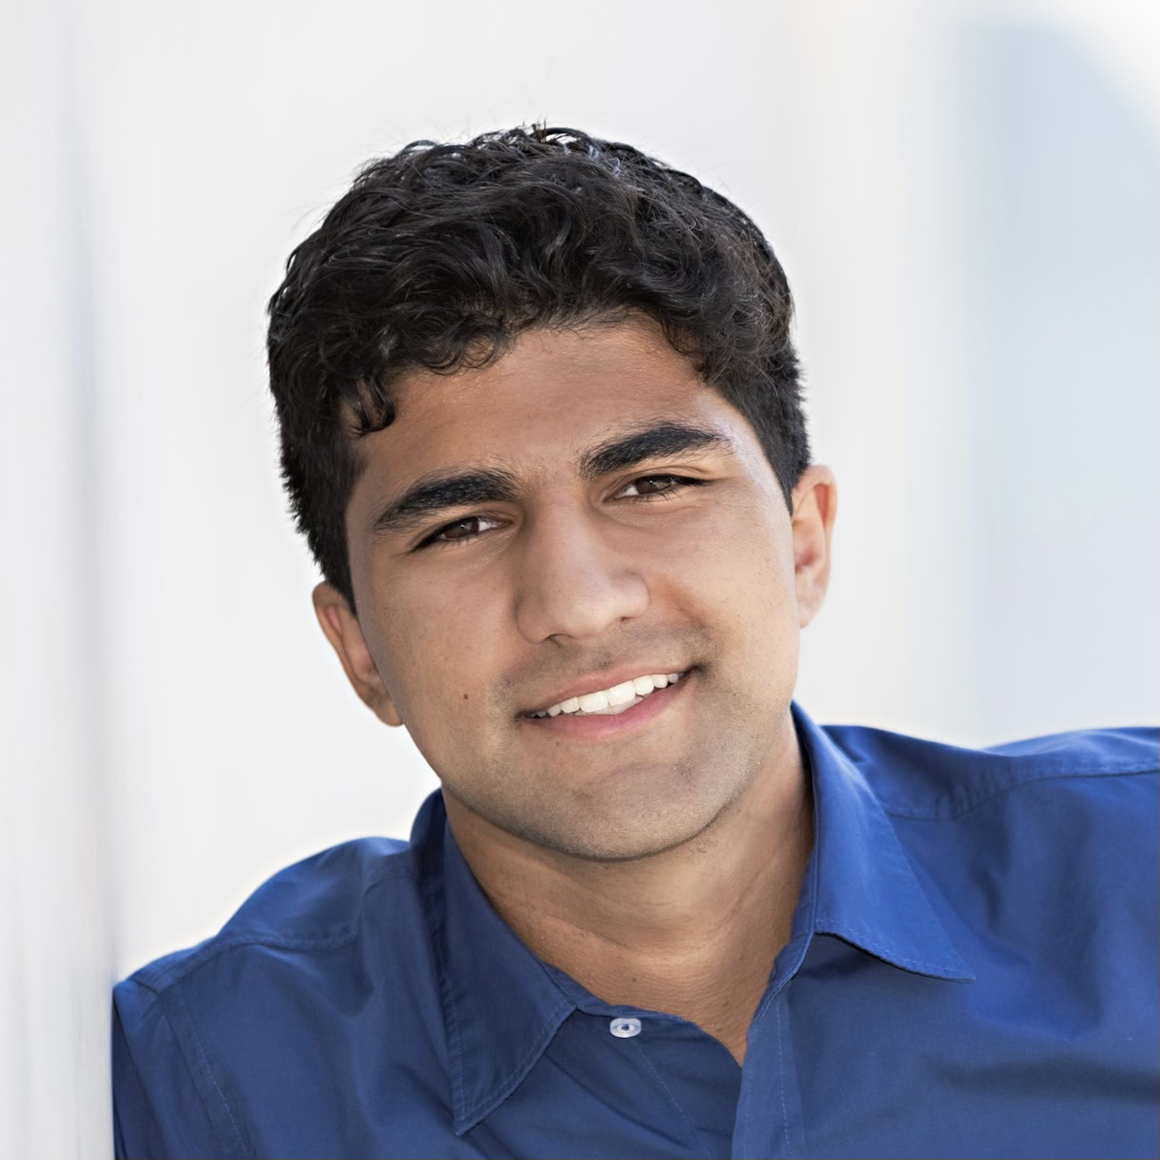
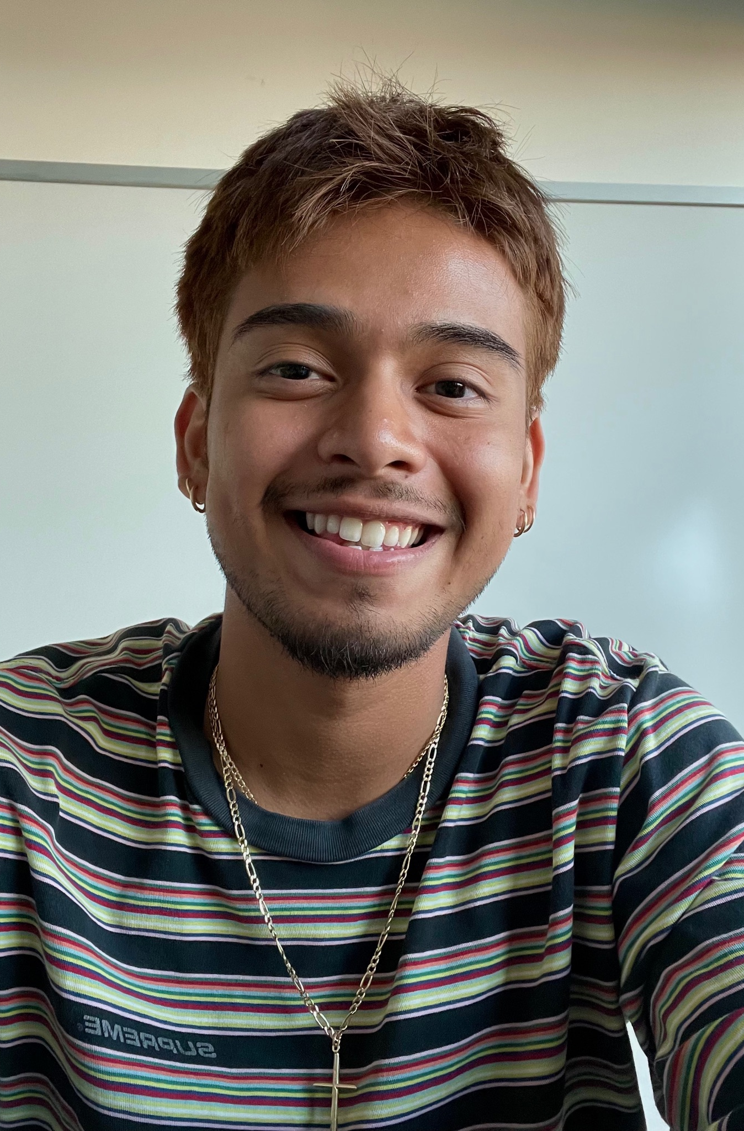
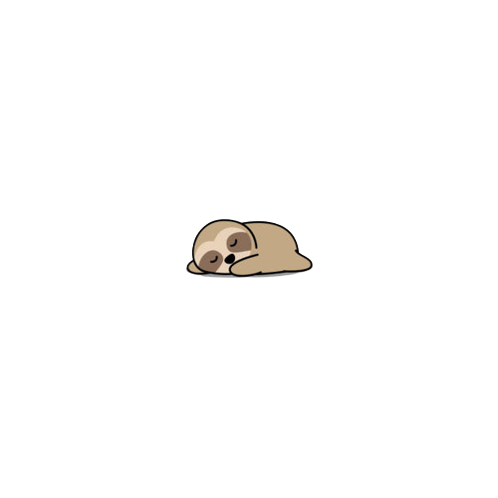
Sleepy sloths
Becky Miller
Marie Chu
Leyth Toubassy
David Castro

Slide 3
Narrowing the Domain
Learning Art
Visual Arts
Early Career
Notes:
Last week we had a broader topic that included a looser definition of art and for this week we focused on narrowing down our topic to more “traditional” art in the subdomains of painting, sketching, drawing, etc. Specifically we were looking at the population in their early twenties that are possibly just starting their careers and recently finished high school education. We wanted to explore how these individuals continue their journey in art outside of the formal education system.

Slide 4
“Learning Visual Art as a Young Adult”

Slide 5
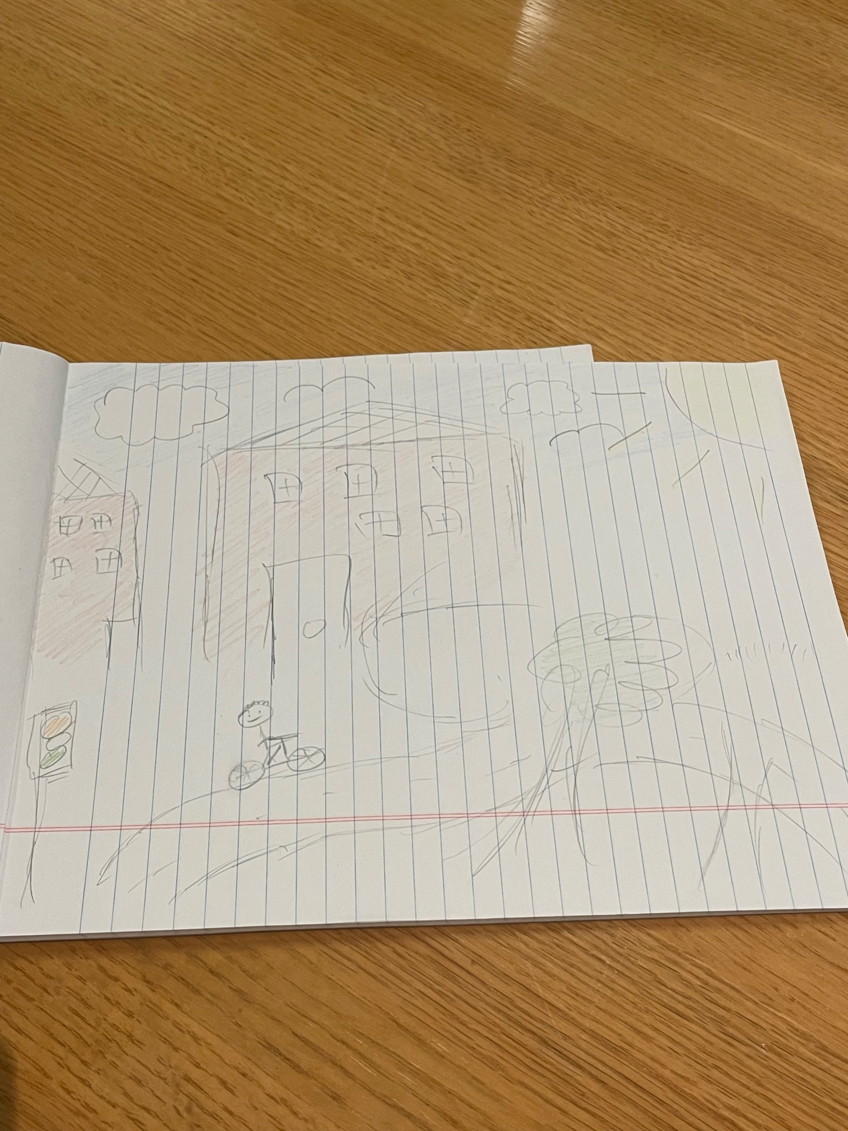
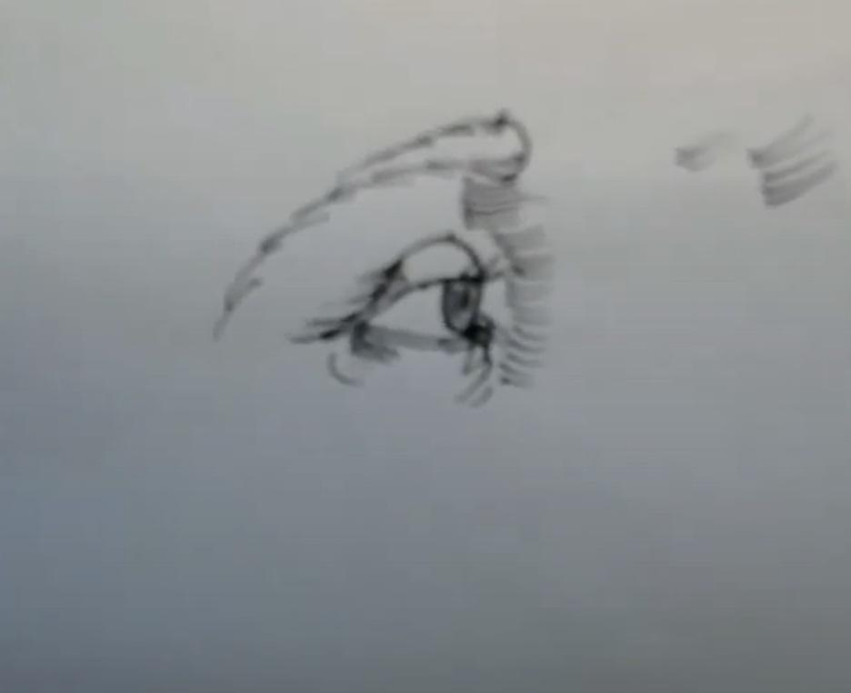
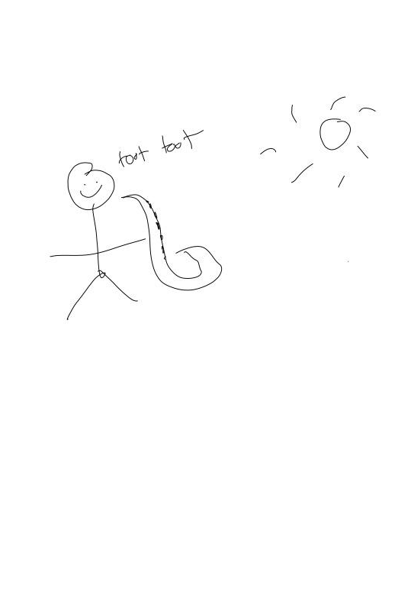
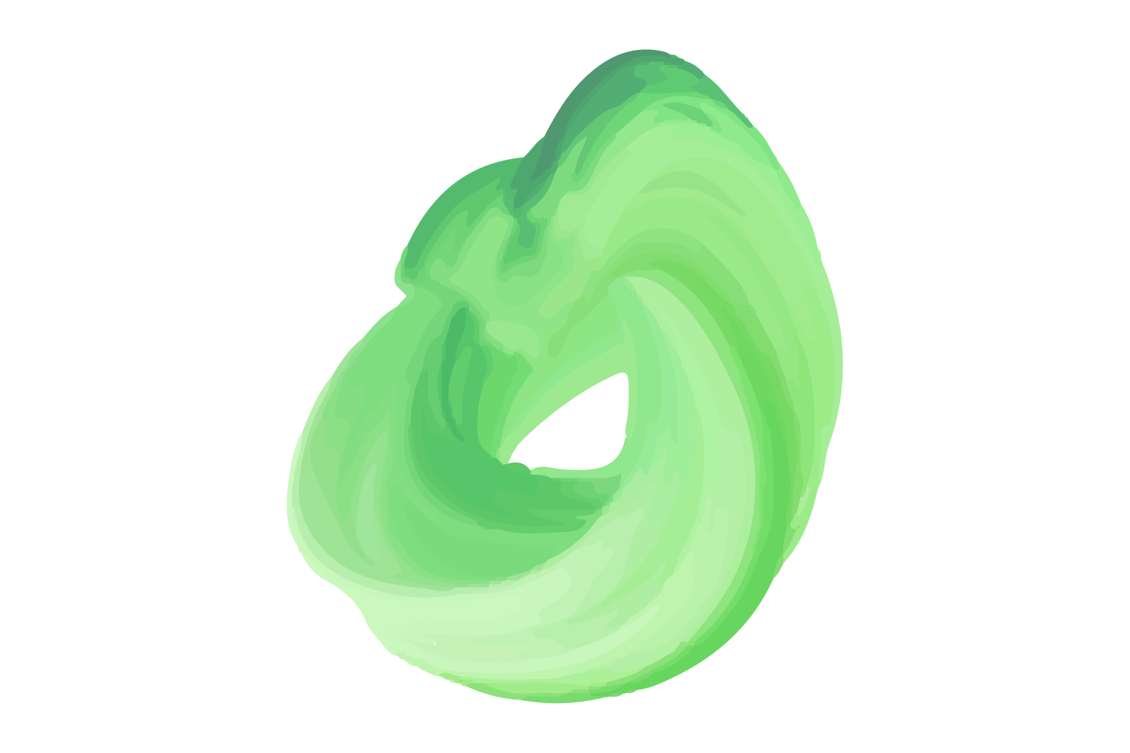
Recap of last week
Sean
PM Intern @ Tesla
Justin
SWE @ Salesforce
Eric
SWE @ Meta
Notes:
Participants: Why were they chosen? Why are they appropriate? How were they recruited/compensated?
Where were the interviews conducted?
Who was your “extreme user”? In what axis are they extreme?
What did you ask?
Team member roles for each interview
Apparatus – any equipment/software used (transcribing, etc.)
Titus:
Art background: Took art classes in middle school w/ his brother. His family is pretty artsy however, doesn’t really prioritize art. (David interview / Leyth notetake)
Alex Lin:
Alex Lin was an extreme user as he picked up and rigorously studied art in his free time during the height of the pandemic. He still continues to learn alongside his full-time job. (Leyth interview / Marie notetake)
Alex Zhao:
Alex Zhao took art classes when he was younger but it never really stuck with him. He was always more into music and has converted that interest into playing rhythm games because consumption is easier than creation. (Becky interview / Marie Notetake)

Slide 6
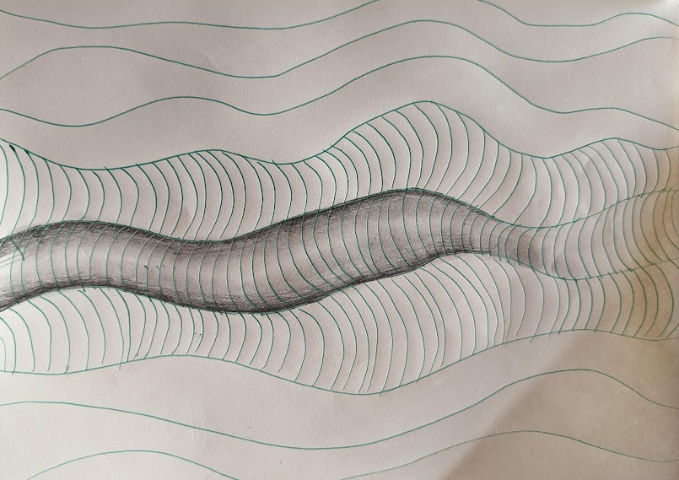
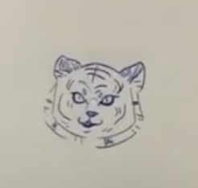
Participants of the Week
Ally
April
Ex-SDE
High School Art Teacher

Slide 7
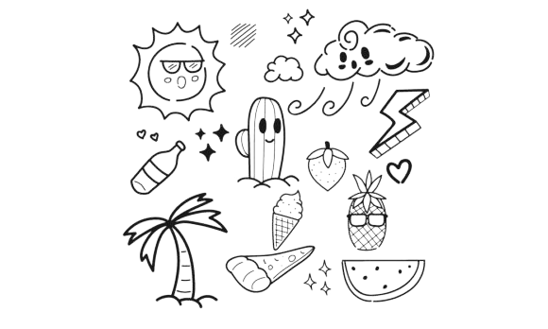
Ally
“I always liked doodling”
“Unless it [art project] is done nobody can look at it”
“I’m a massive introvert and art is my relaxing period of time and sometimes I don’t want to share that with another person”

Slide 8
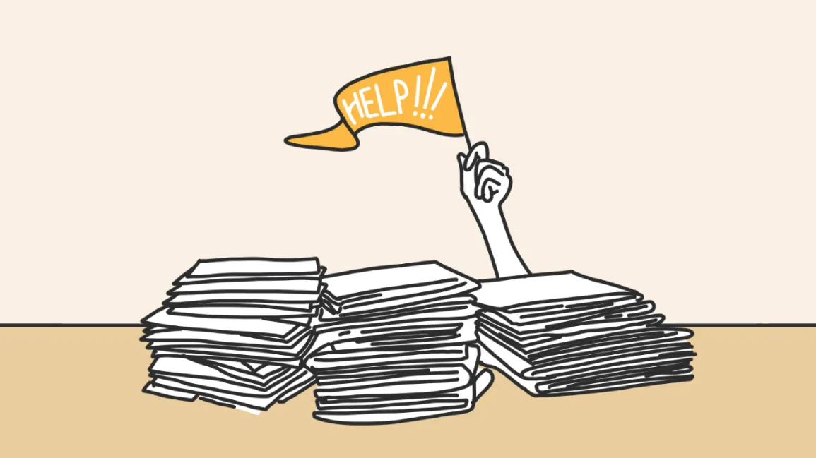
Learnings
Unpaced learning of rigorous drawings can lead to burnout
Enjoyed painting and drawing alone as it was their “relaxing” time but prefers doing pottery with others.

Slide 9
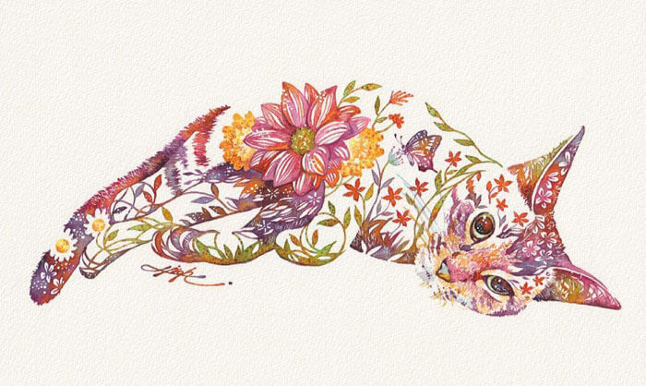
April
“My grandma liked painting flowers and animals and I did a lot of arts and crafts with her.”
“Art is a confidence booster and makes me feel beautiful”
“Art to me means: color, magic, and beauty. It is intentionally bringing attention to something”

Slide 10
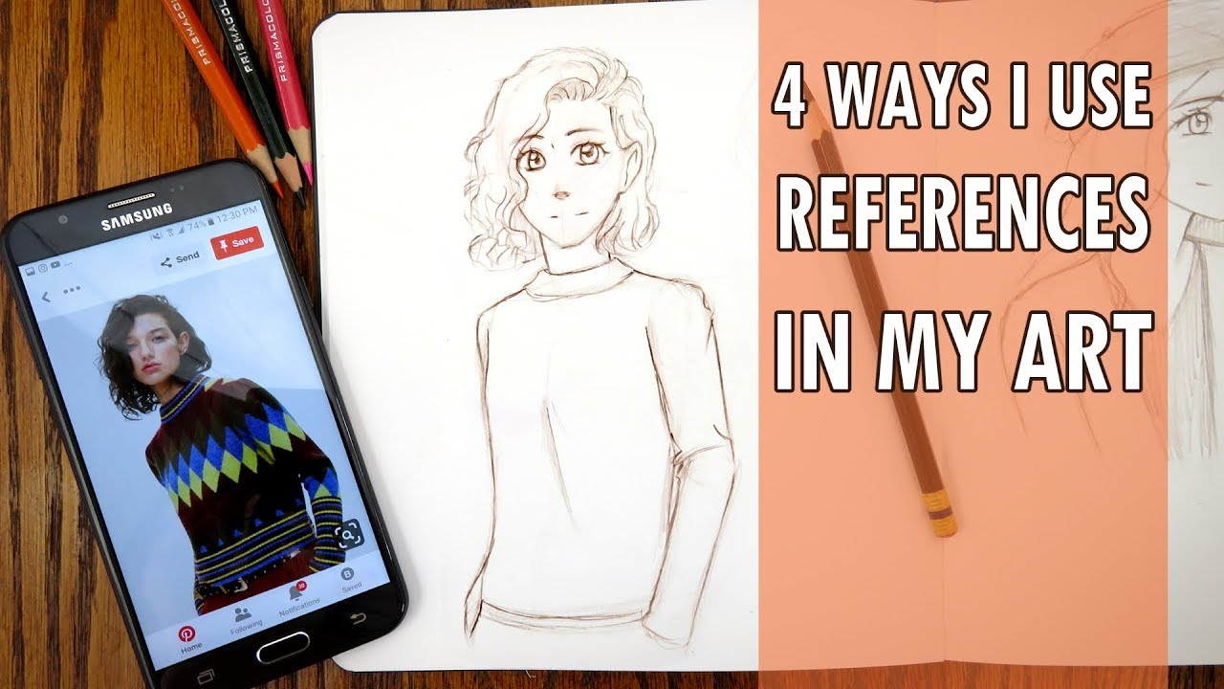
Learnings
Love for art was innate
Art vision was separate from the technical skills
Student’s always copied references because they wanted something “good”

Slide 11
POV’s that didn’t make the cut

Slide 12
Povs
We Met…
We were surprised to notice…
Justin, a recent grad working as a Software Engineer at Salesforce. Over the pandemic he started art seriously
he had a difficult time learning art when there are so many resources available online
WE wonder if this means …
It would be game- changing to…
he felt overwhelmed by all the resources and didn’t know where to start
gather a condensed set of resources for beginners who are interested in learning art

Slide 13
Povs
We Met…
We were surprised to notice…
Eric, a software developer in his early twenties who did some drawing and painting in middle school but is more involved with music
he is proud of things he works hard on, but enjoys mediums that come to him more easily
WE wonder if this means …
It would be game- changing to…
he feels frustrated when progress isn’t visible in the learning process
make the process of learning art engaging and fulfilling for Eric

Slide 14
POVS
We met …
We were surprised to Notice …
Ally who has always been passionate about art, self-learning multiple mediums to express herself starting with drawing
although she enjoys art so much, she doesn’t remember pieces that she’s done or any pieces that she’s particularly proud of
We wonder if that means …
It would be game changing …
she’s just unwilling to share her work with others because she doesn’t want to be judged on it if she thinks one of her works are good but others don’t
provide Ally with a way to share her are and receive feedback on it in a positive manner

Slide 15

Final Pov #1
We Met…
We were surprised to notice…
Sean who is currently a student studying computer science at Seattle University. He appears to be apathetic towards art.
that despite coming from an artistic family and enjoying doing art with others, he doesn’t consider art a priority and thinks its a waste of time.
WE wonder if this means …
It would be game- changing to…
he feels inferior to his family members in terms of his artistic skills which causes him to have a negative attitude towards learning art.
give Sean a safe space to learn and enjoy art without comparing his work with others

Slide 16
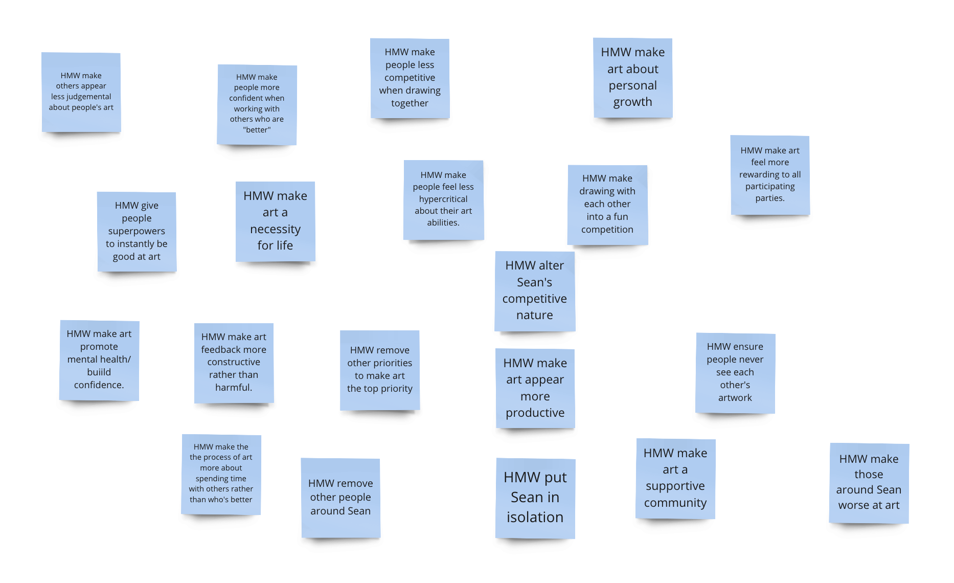
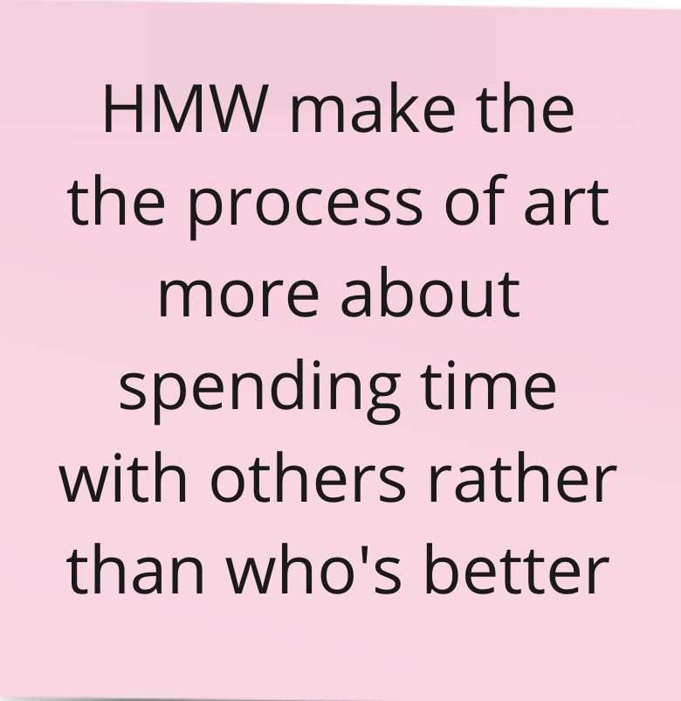
How might we …

Slide 17
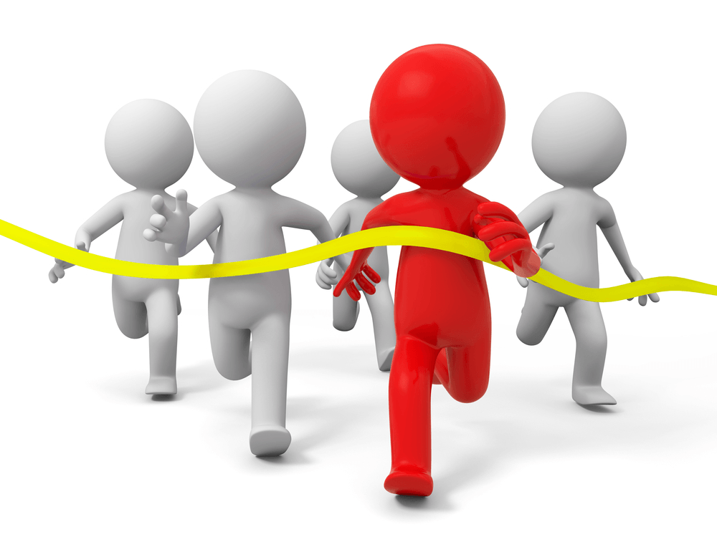
Experience Prototype #1
Solution:
Have a game where people try to draw as badly as they can.
Key Assumption:
People will be able to enjoy the process more and the company of who they’re drawing with as they don’t feel the innate pressure to draw well.

Slide 18
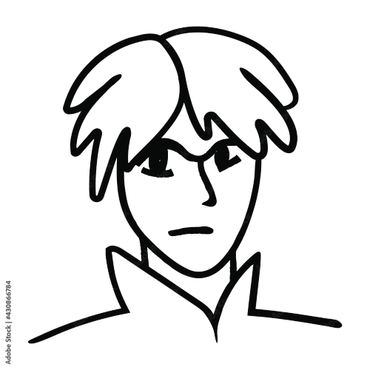
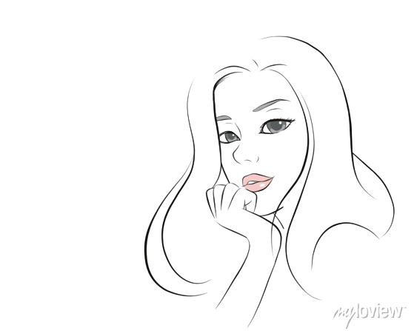

Design #1
Task:
Draw the best you can for 5 mins (with a shared prompt)
Draw badly for 5 mins (with a shared prompt)
Participants:
Austin
Angela
Stanford PhD (age 23)
Meta SWE (age 25)

Slide 19
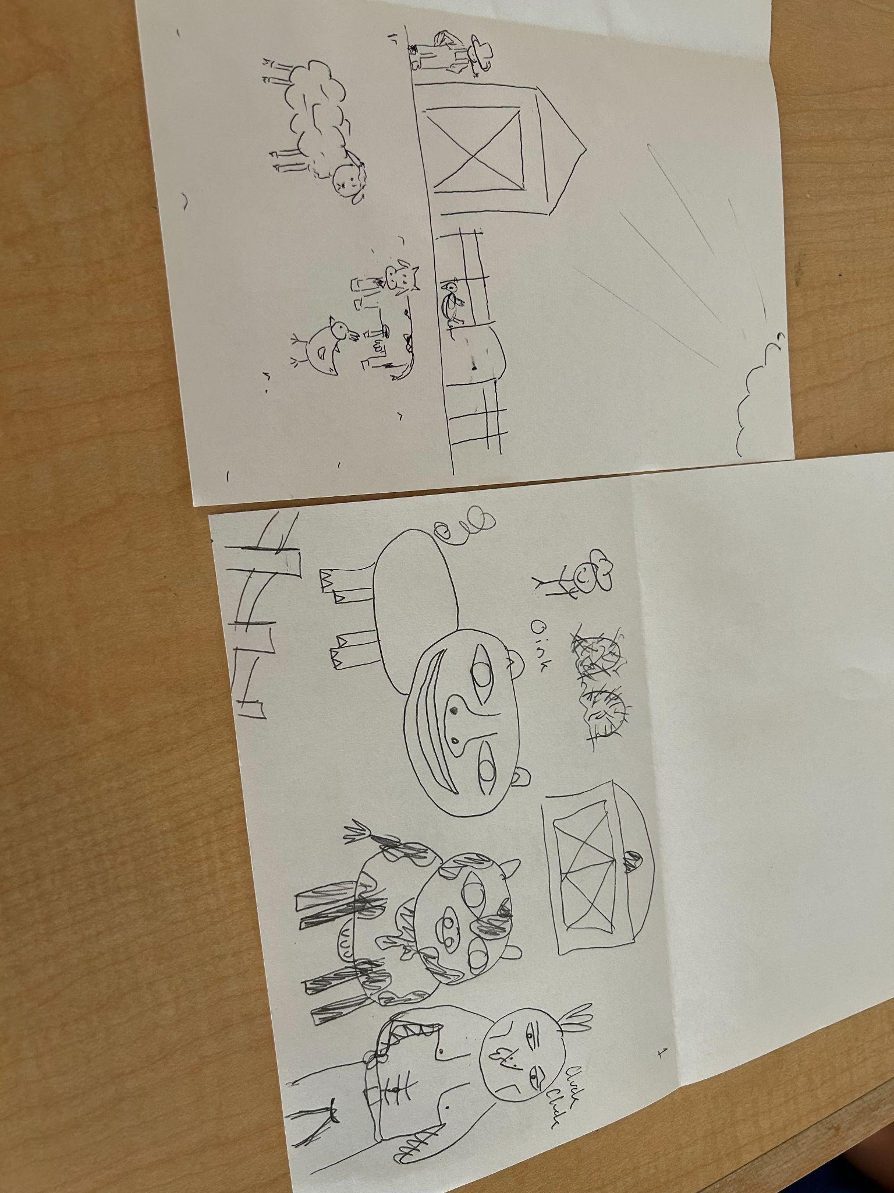
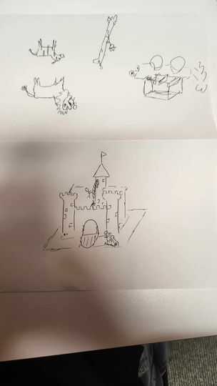
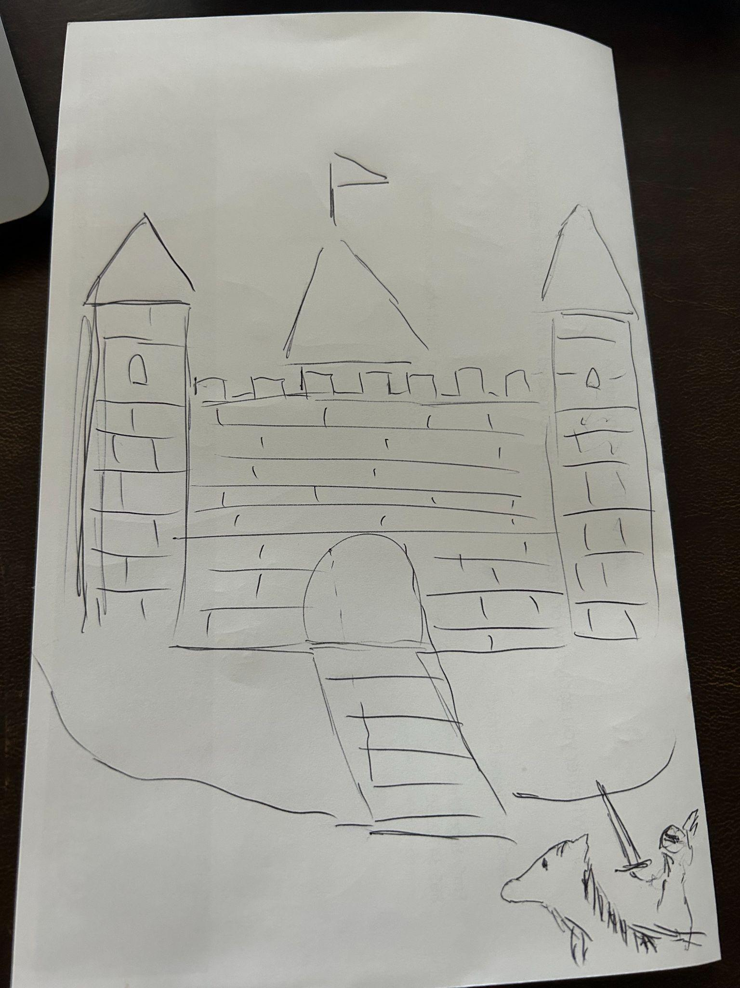
Draw The Best you can

Slide 20
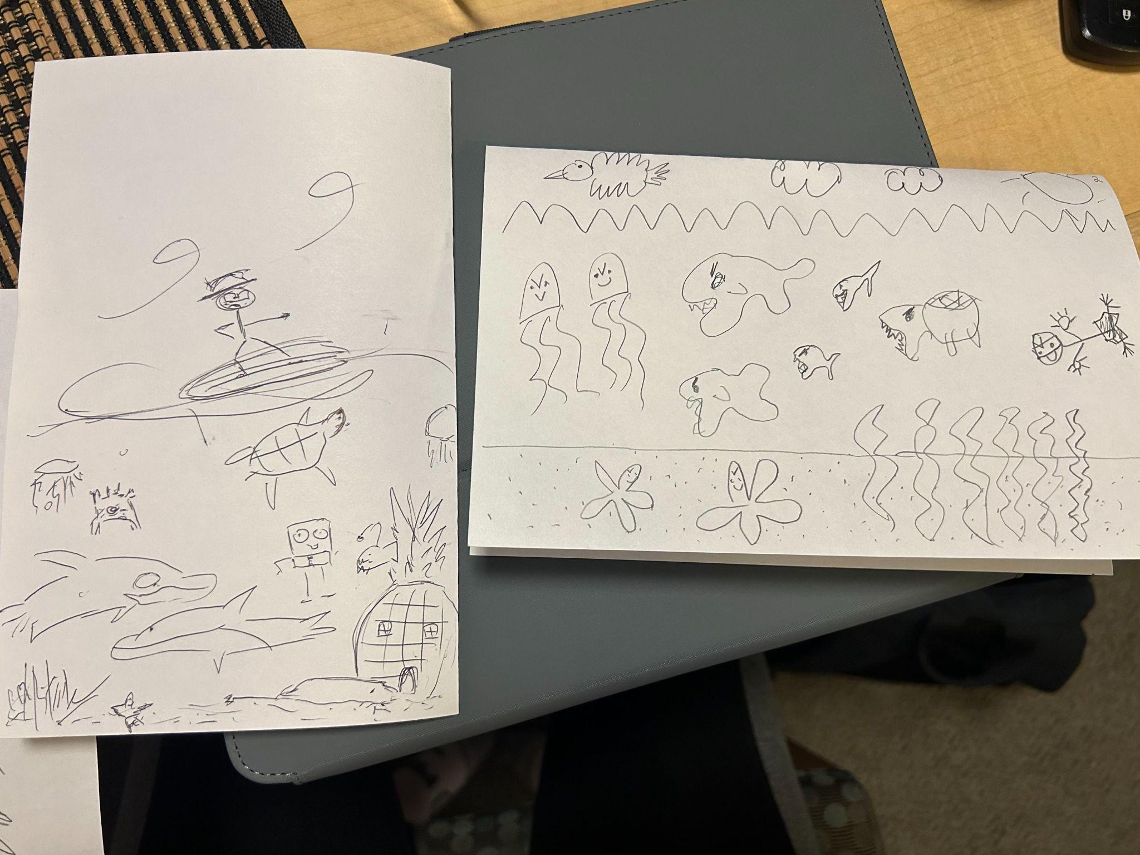
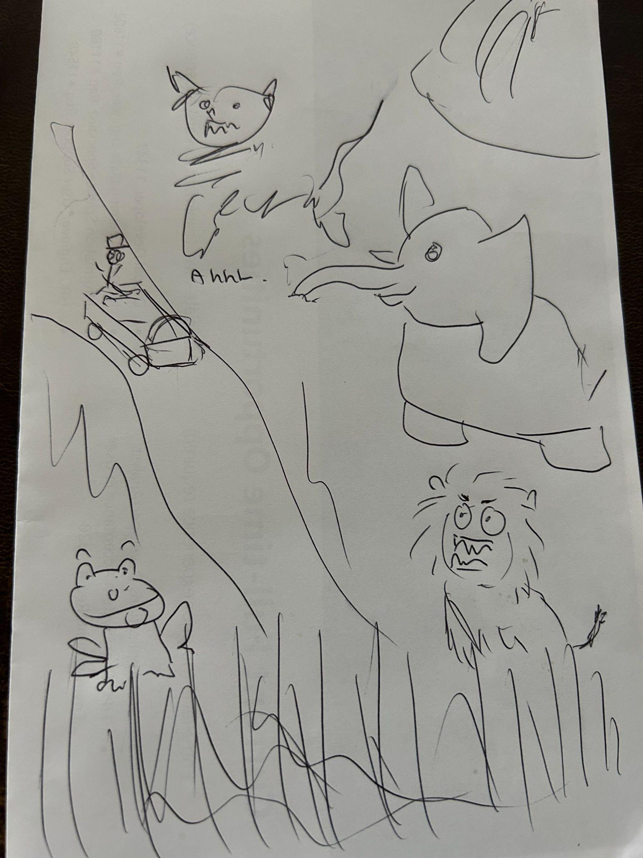
Draw The
Worst you can

Slide 21
Key findings #1
What worked:
People felt less “judged” for their drawing when given the “bad prompt”
People enjoyed drawing with others
Without the pressure to draw well, people drew whatever was on their mind
What didn’t work:
Depending on the person’s personality trying to draw badly either made them feel hindered or more expressive.
People’s behavior changes depending on how familiar they are with the person they’re drawing with – with strangers they prefer the “drawing badly” prompt
Preferred having a piece that looked good and they were proud of
Key Findings:
When people feel held back in some way, it’s harder for them to enjoy the drawing process
Sharing the experience of drawing with others is fun
People experience different levels of pressure to draw well depending on how high the stakes are

Slide 22
Final Pov # 2
We Met…
We were surprised to notice…
Justin, who picked up art during the pandemic when he was bored and alone at home. He continued to learn art and now takes online art classes in addition to his full-time job.
he believes the community and structure of art school is more important than the content, but he doesn’t interact with his peers and would rather draw.
We wonder if this means …
It would be game- changing to…
academic pressure to complete his homework forces him to view interactions with his peers as a waste of time when he needs to be more “productive” to complete his homework.
allow people to learn art while also emphasizing the interaction with other artists.

Slide 23
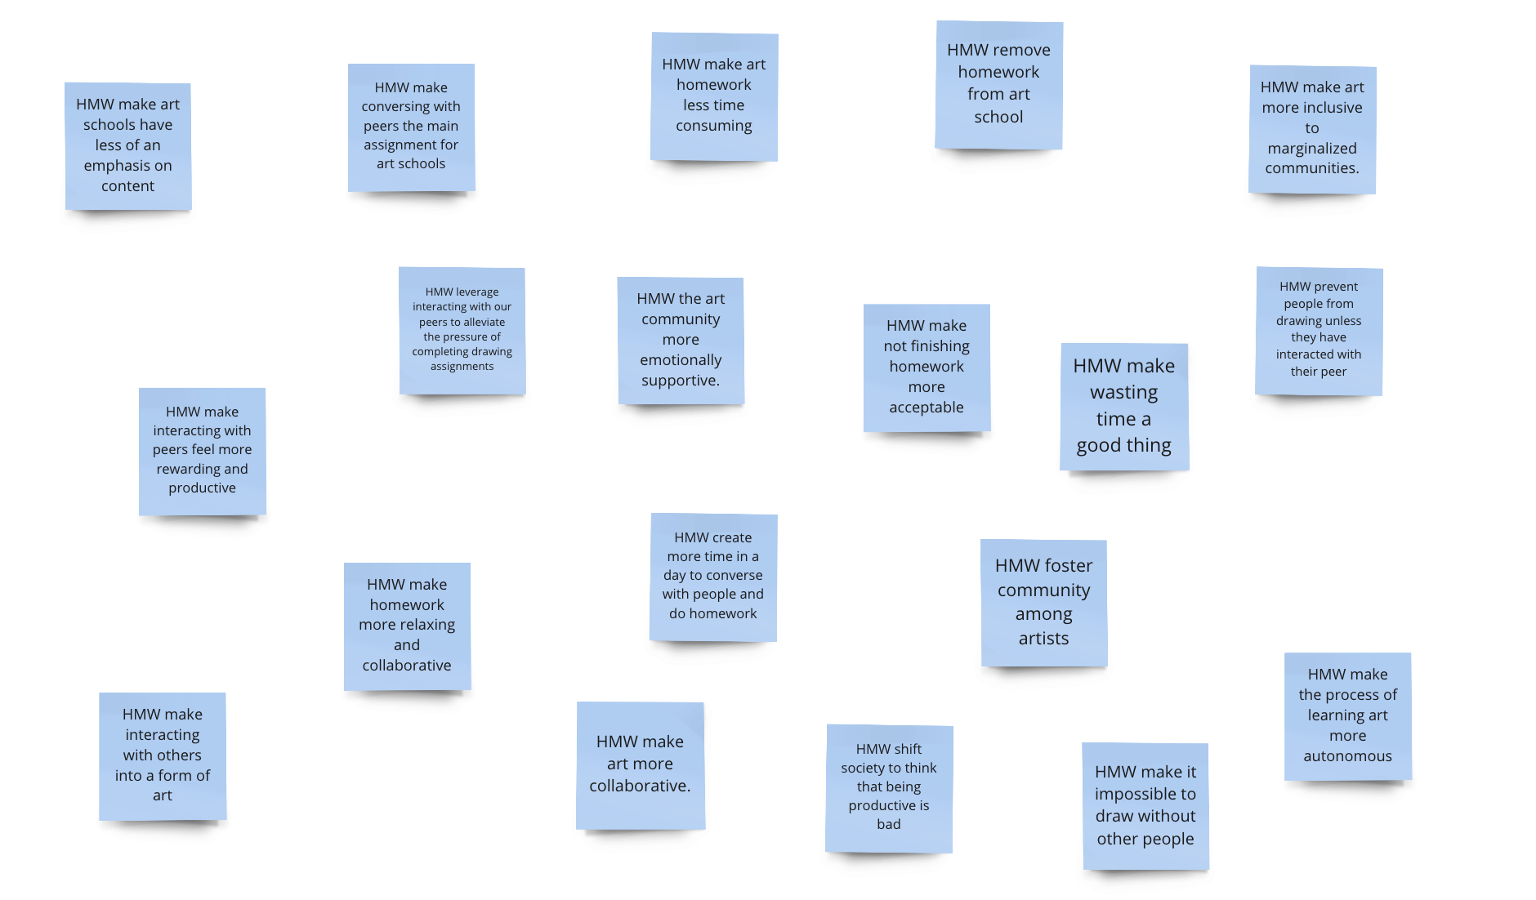
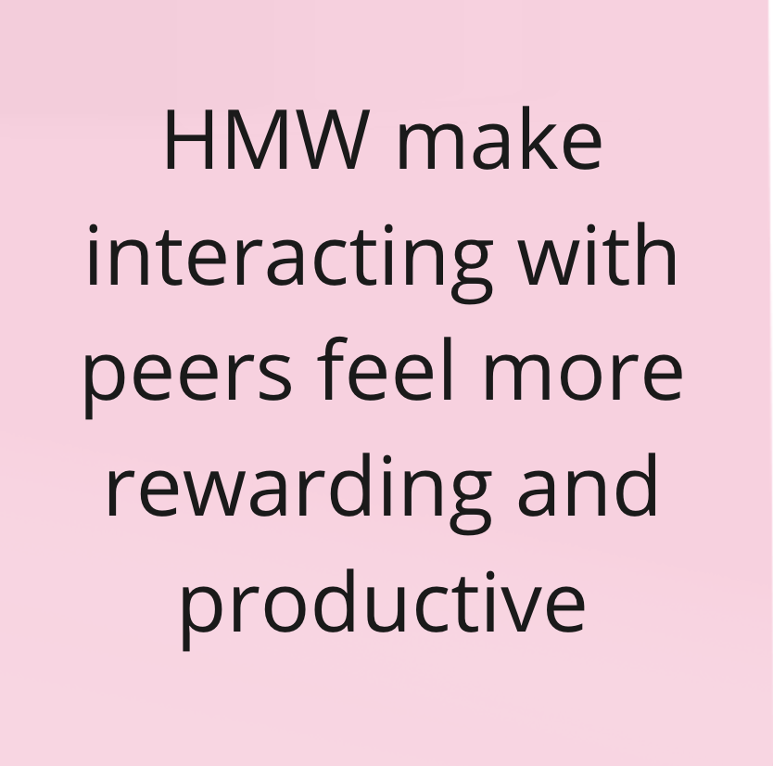
How might we …

Slide 24
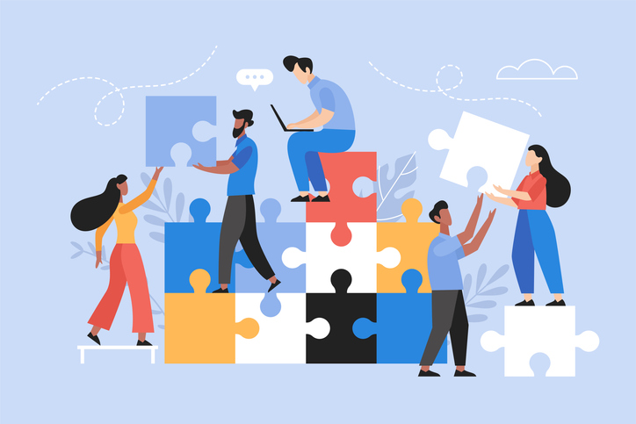
Experience Prototype #2
Solution:
Have people draw together to create a single piece of art.
Key Assumption:
Leveraging the minds of different individuals can lead to more ideas and better results.

Slide 25
Design #2
Task:
Draw something by yourself
Draw something on the same paper with another person
Participants:
Austin
Leslie
Stanford Matsci PhD (age 23)
Stanford Student (age 20)

Slide 26
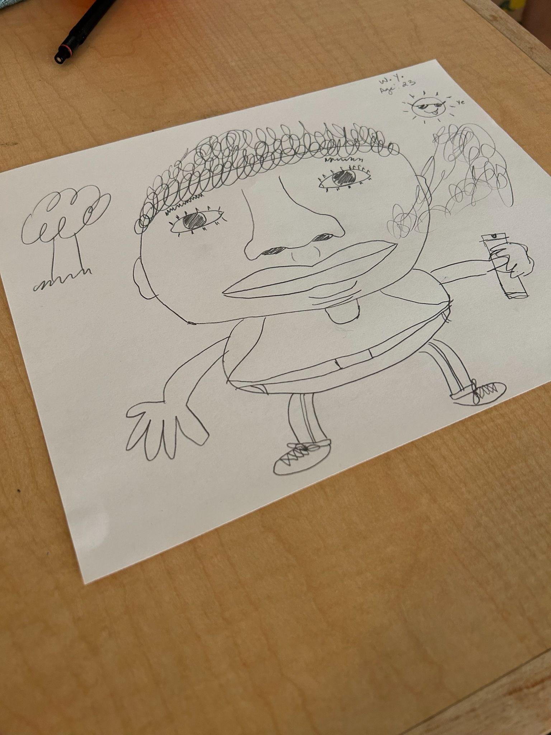
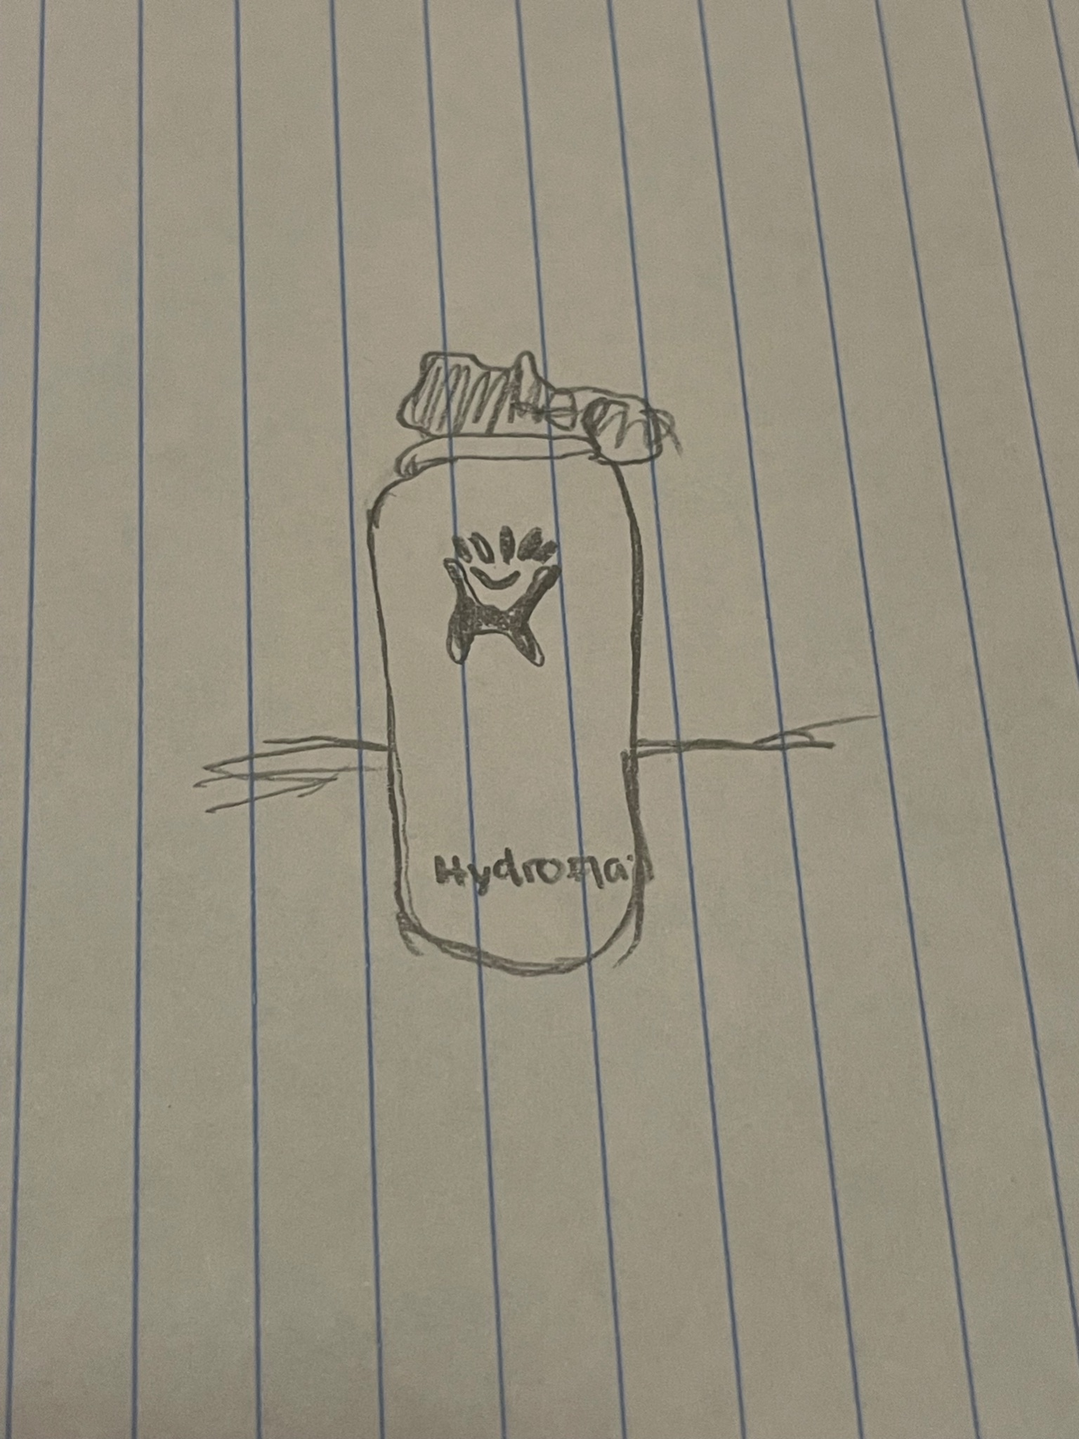
Draw something by yourself…

Slide 27
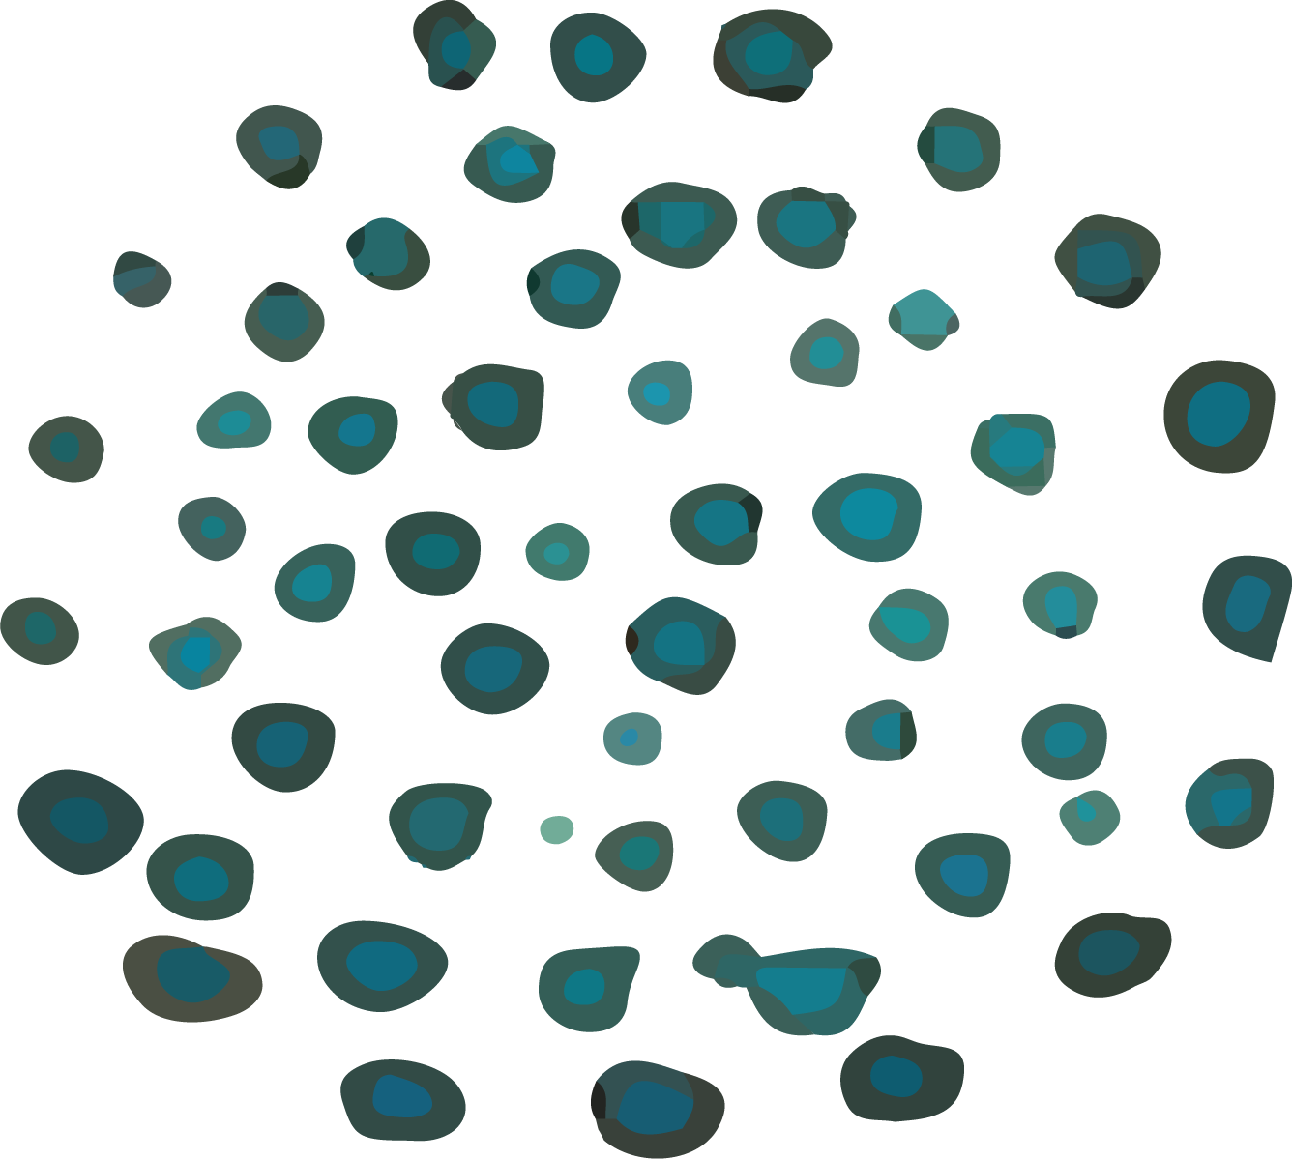
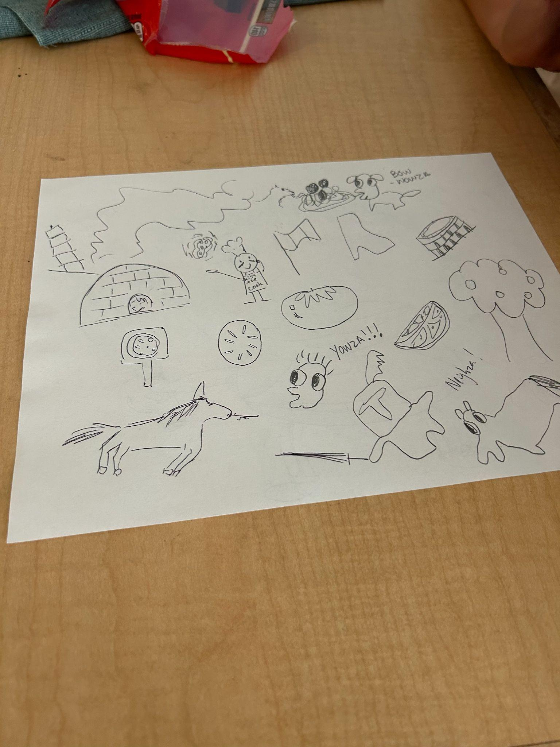
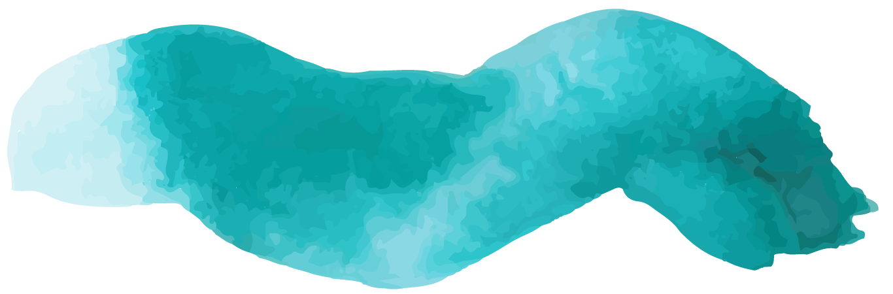
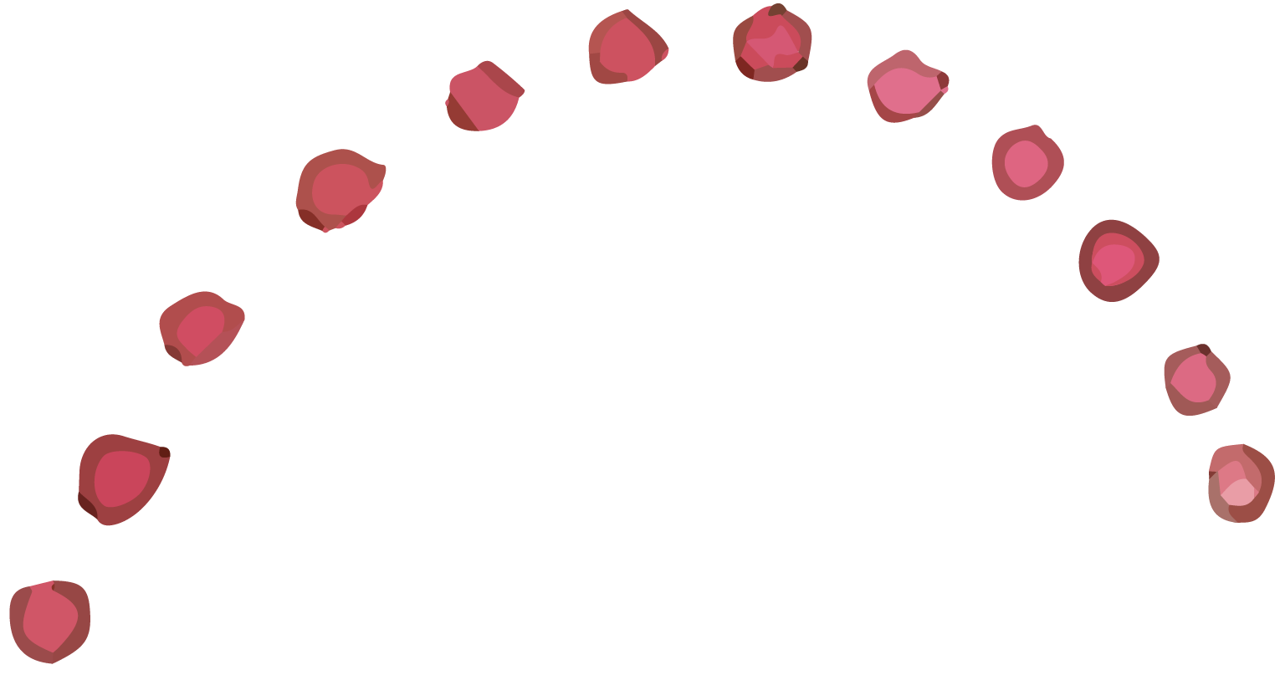
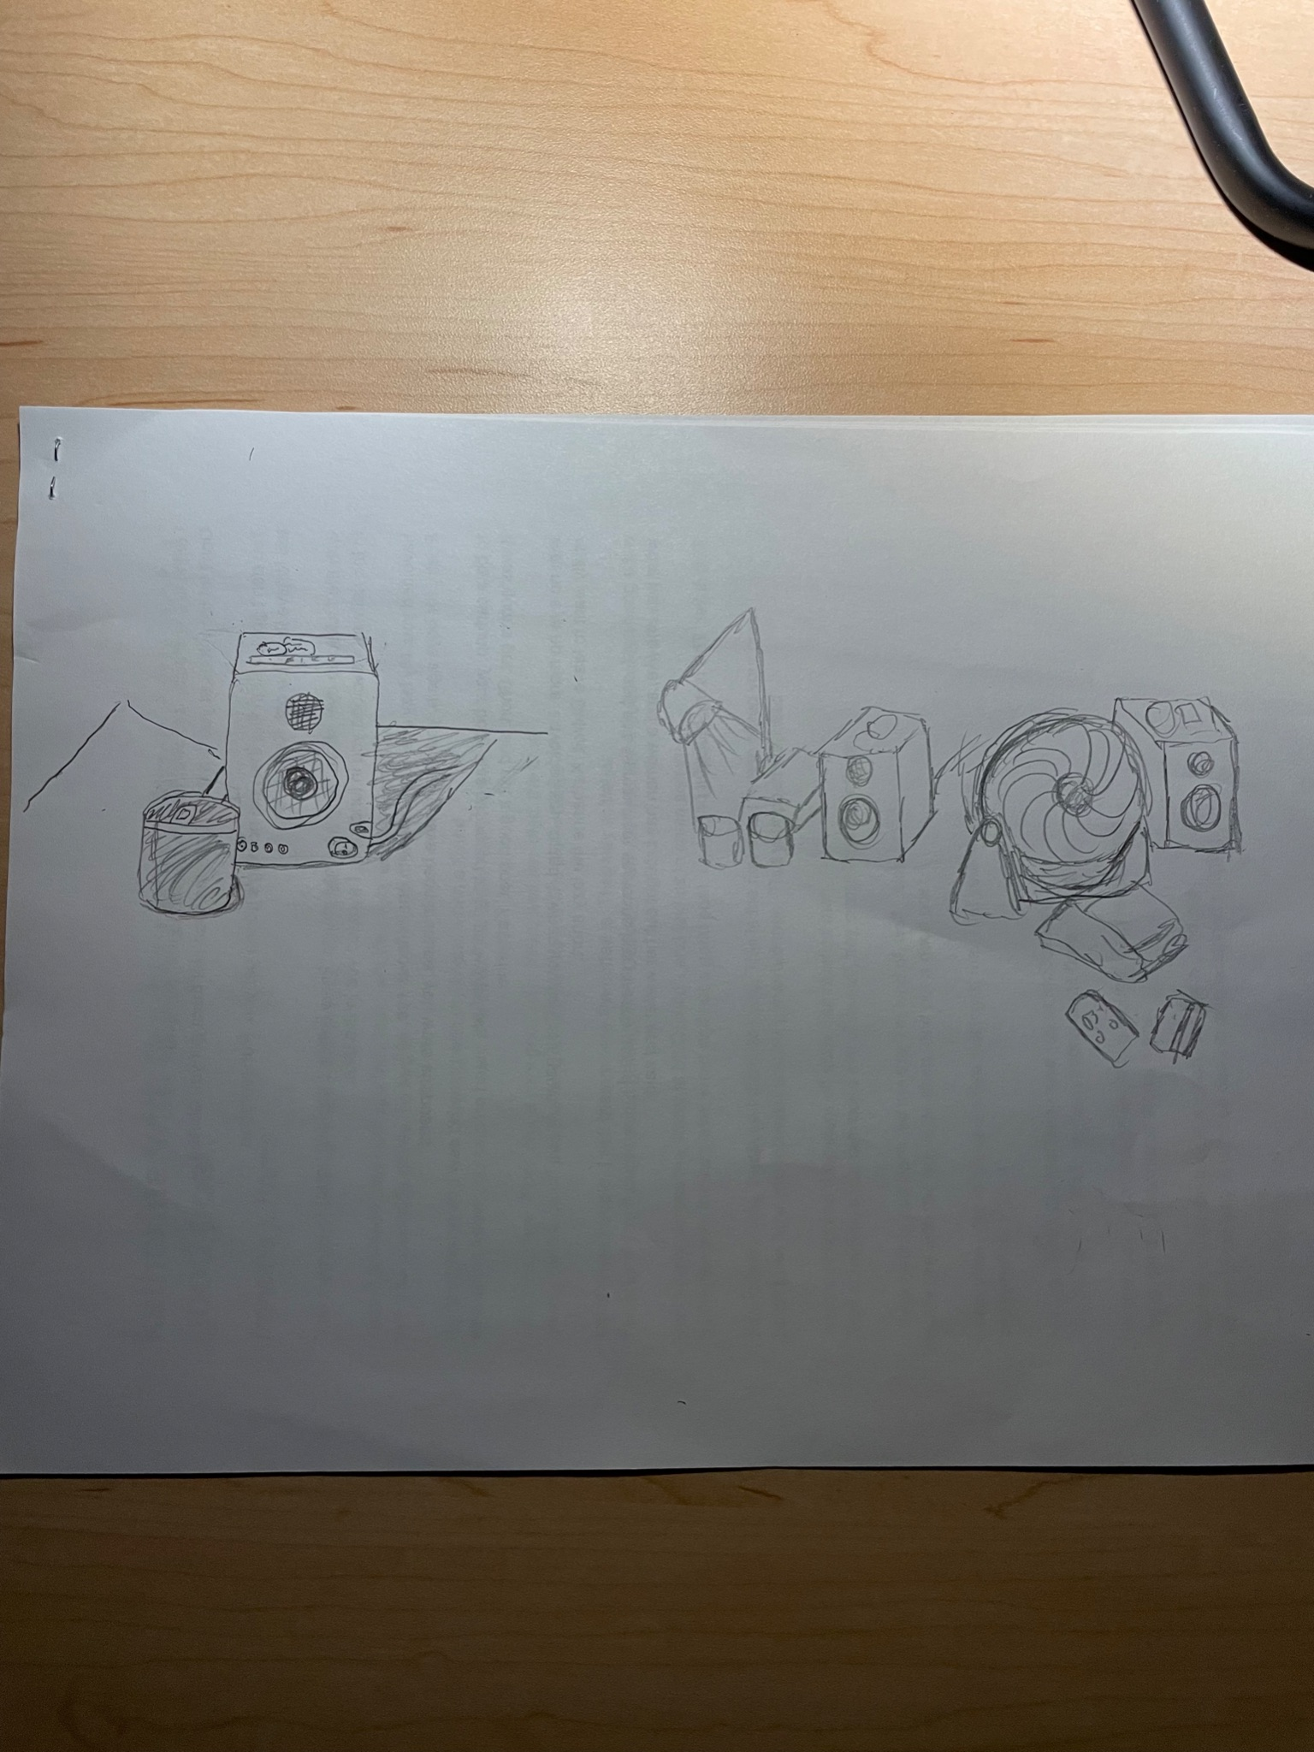
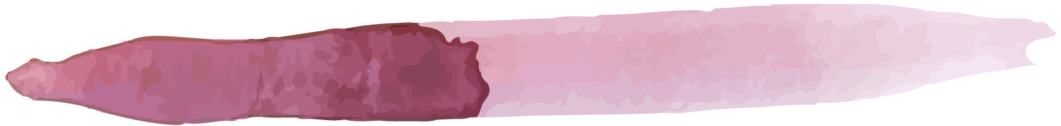
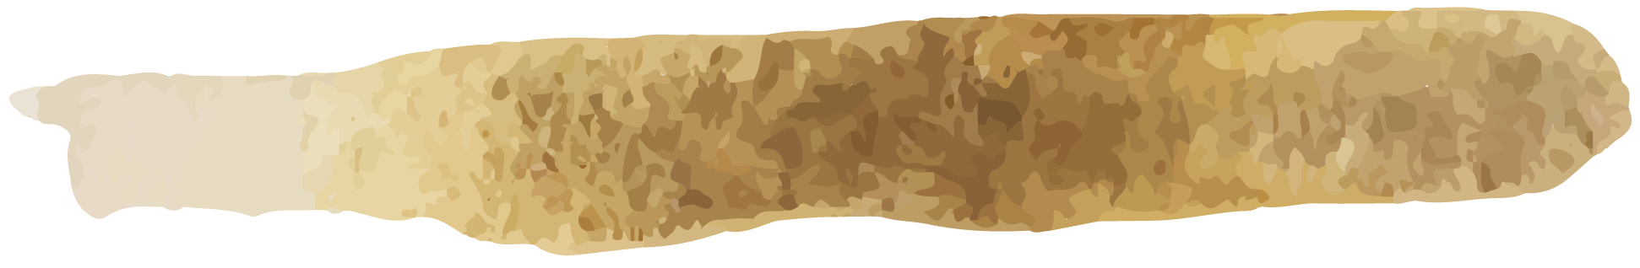
Draw something with someone else…

Slide 28
Key findings #2
What worked:
Easier to generate ideas of what to draw
Piggyback off of others ideas
People enjoyed drawing with others
What didn’t work:
Level of enjoyment depends on how well they know the other party
Difficult to draw together on the same paper
Depending on artistic ability some felt discouraged to draw.
Key Findings:
Drawing with others allows people to generate more ideas in a faster period of time and step outside the box.
People enjoy drawing with others

Slide 29
Final POV #3
We met …
We were surprised to Notice …
April who is a high school art teacher in San Francisco. It is her first year teaching. Art has been a key part of improving her mental health, and feeling comfortable in her own skin.
that she developed her ability to artistically express herself in parallel with her technical artistic abilities. However her students struggle with this and often only focus on technique.
We wonder if that means …
It would be game changing …
new artist’s lack of technical skill is a barrier to them experiencing deep meaning and motivation in their drawings
help artists create their artistic vision without relying on purely technical skills
Notes:
Long Version: that one of her favorite, most meaningful pieces is one that was technically easy because it allowed her to express herself more directly, whereas when improving her technique, she ended up not using the concepts and artistic spirit that were very important to her. She also noted she saw a similar divide in their students, who generally focused on the technique side. [explore creative concept and artistic composition, but her students don’t share that ]

Slide 30
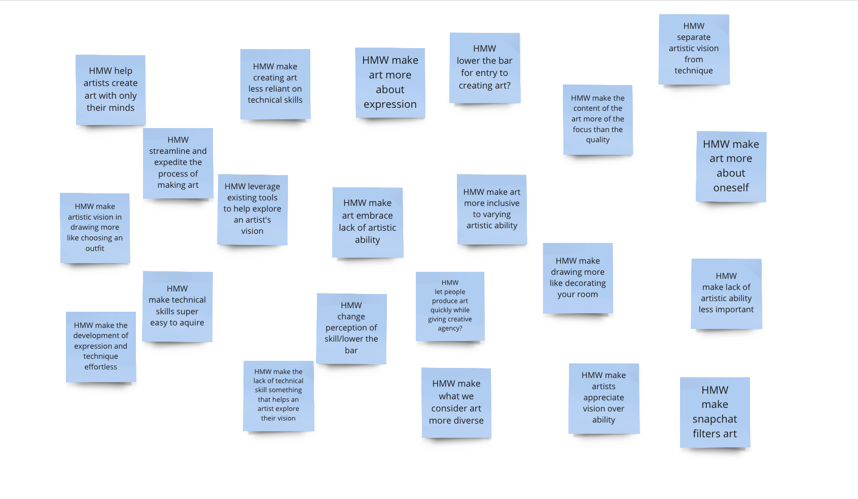
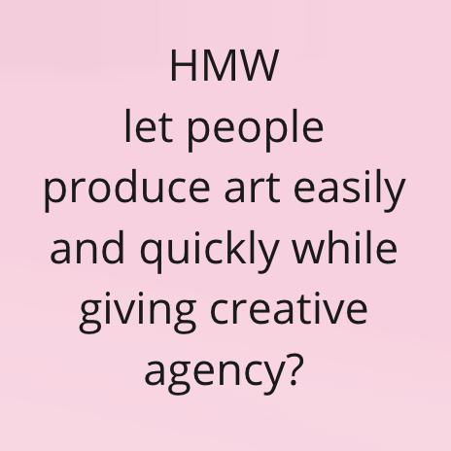
How might we …

Slide 31
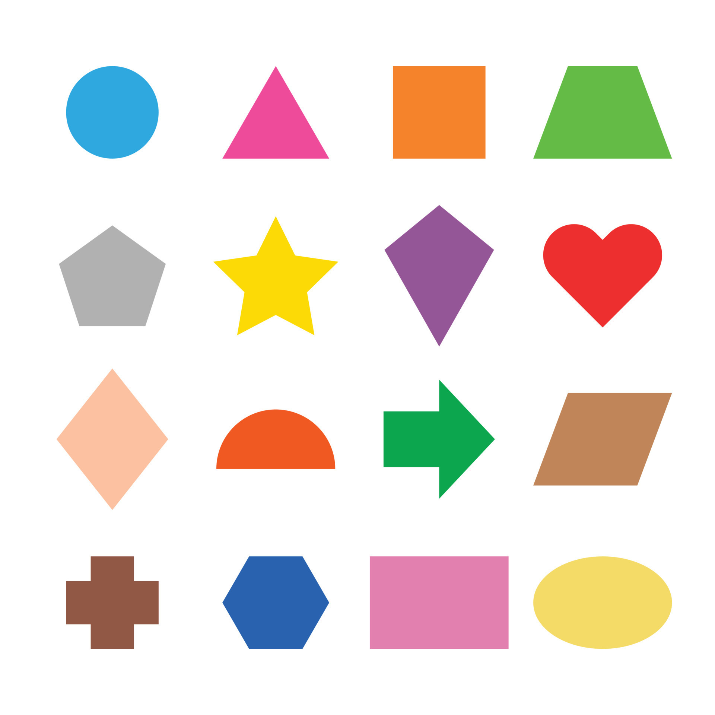
Experience Prototype #3
Solution:
Have participants rearrange printed out shapes and images into some art form
Key Assumption:
Drawing components of a piece takes a lot of mental concentration and capacity, limiting creative outlet. The easy of moving shapes around frees up creativity.

Slide 32
Design #3
Task:
create “a creature” from provided components
Participants:
Dora
Terry
Stanford Undergraduate Student
Stanford Undergraduate Student

Slide 33
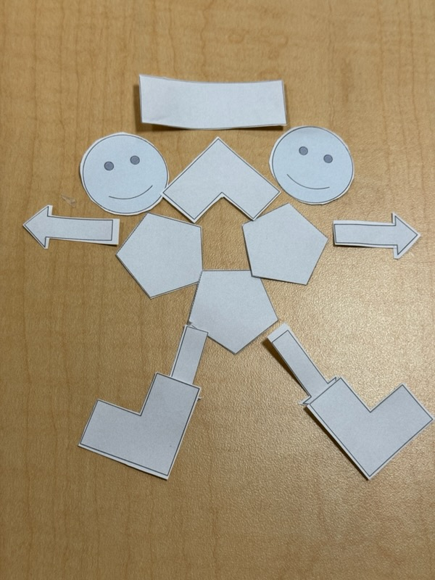
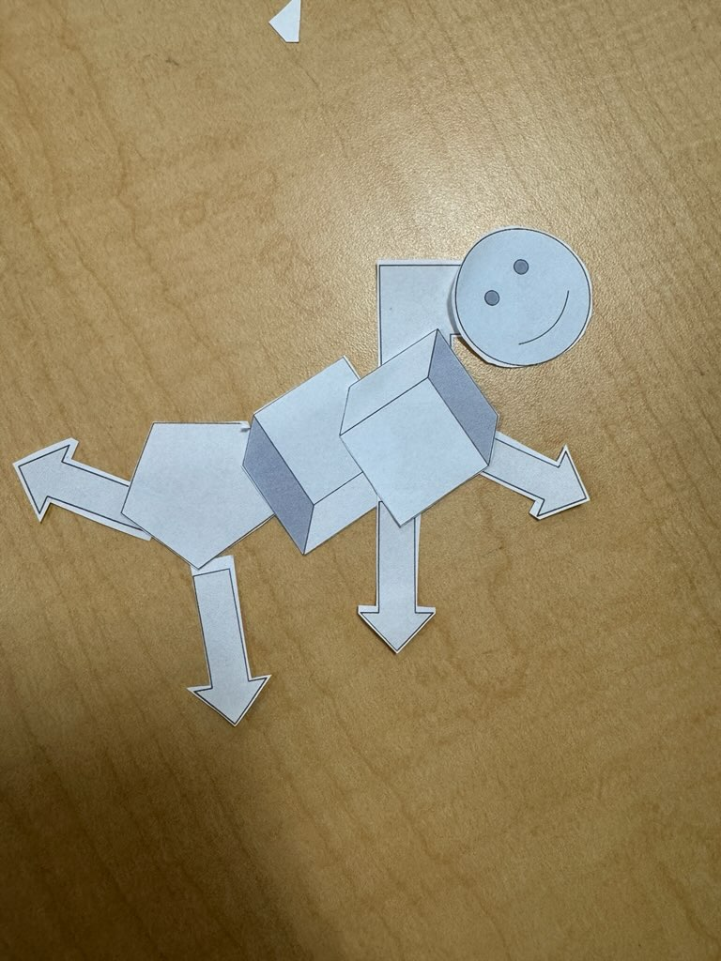
Caterpillar and Gerald
Here are two of the “creatures” made by our participants.

Slide 34
Key findings #3
What worked:
Participants said they “actually” had fun.
No stress caused by needing to draw “well”
Making the creatures was a fast and iterative process, could rearrange as they went
What didn’t work:
Artistic fidelity was low
Process was so fast that it wouldn’t make for very long term projects
Key Findings:
Introducing this “cap” to artistic fidelity allowed people to not stress since their piece would look silly anyways
People were able to make a finished piece very quickly, and had fun talking about their work and the choices they made.

Slide 35
What’s Next
What solutions move forward?
What are the ethical implications of this solution?
Who does it serve? Who does it leave out?
An app that allows you to connect with your peers to learn art vision and skills. Collaborative functions will exist that allow you to share canvases and work together to unlock new art skills.
Could be leaving out people in more marginalized communities that don’t have access to this technology and lead to more social stratification
Serving early age individuals who are interested in drawing
Leaves out people interested in drawing more traditionally with pencil and paper – there could possibly be two “modes” to deal with this.

Slide 36

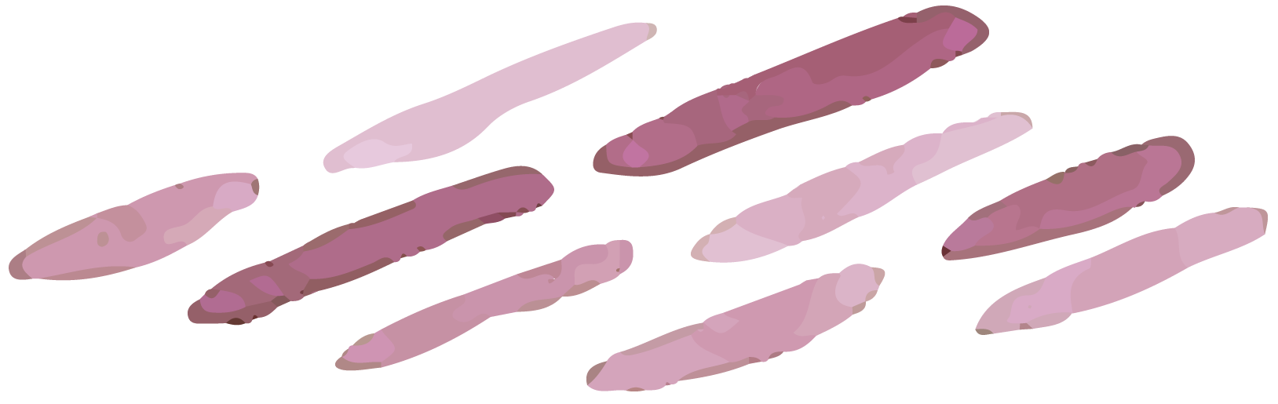
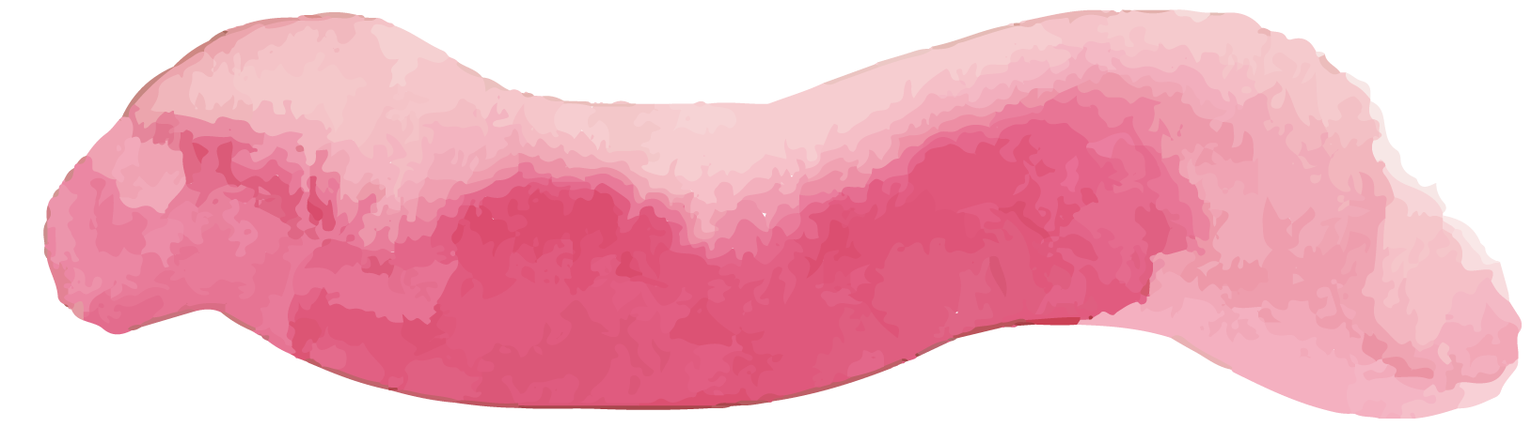
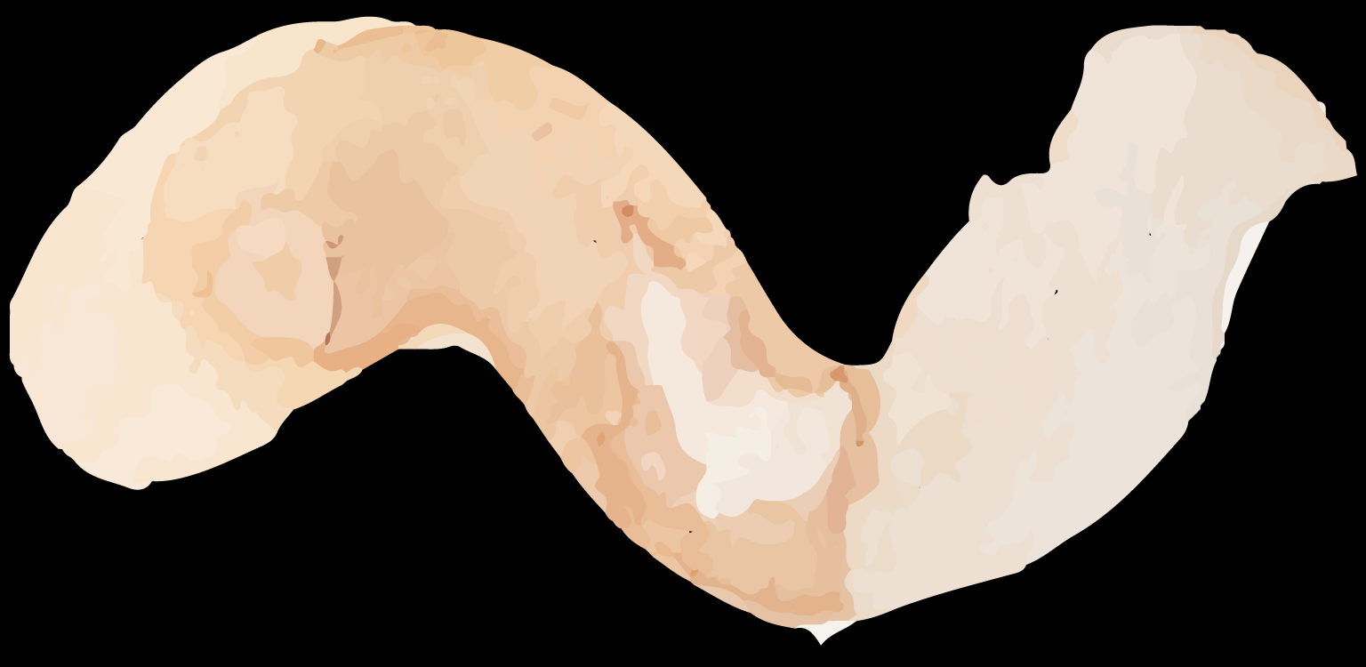

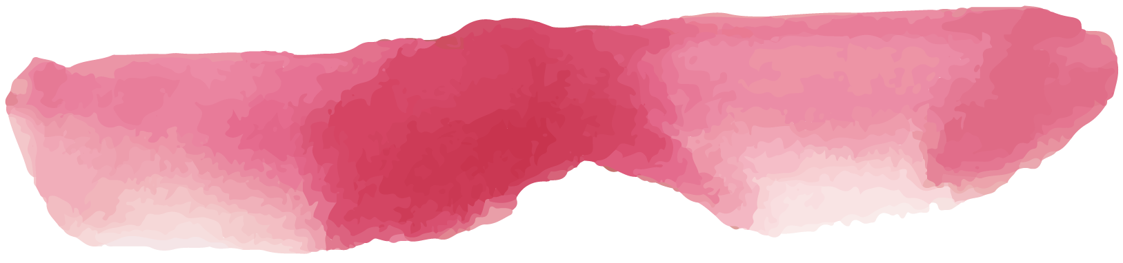
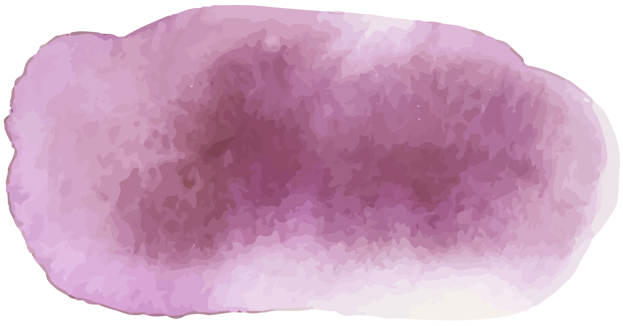
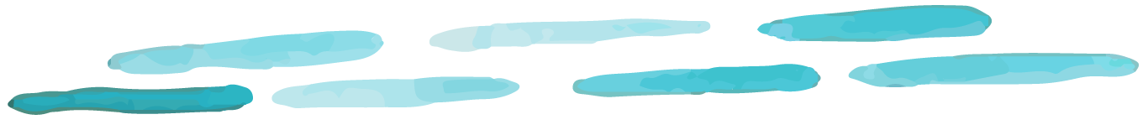
THANKS!
Please keep this slide for attribution

Slide 37
Appendix

Slide 38

HMW make the the process of art more about spending time with others rather than who's better?

Slide 39

HMW make interacting with peers feel more rewarding and productive?

Slide 40

HMW make the the process of art more about creative expression than learning techniques?

